Slide 1




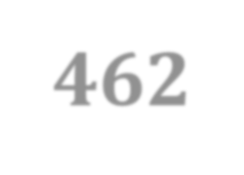
Artificial Intelligence

Slide 2

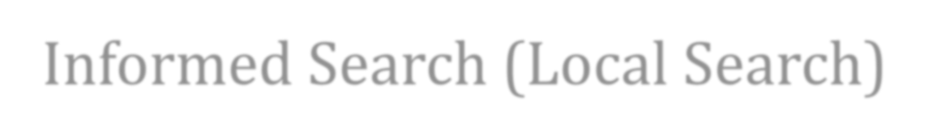



Today’s Learning
Informed Search (Local Search)
Hill Climbing Local Beam Search Genetic Algorithms

Slide 3
L o cal search
Search algorithms seen so far are designed to explore search spaces systematic a lly.
Problems: observable, deterministic, known environments where the solution is a sequence of actions.
Real-World problems are more complex.
When a goal is found, the p a t h to t h a t goal constitutes a solution to the problem. B u t , depending on the applications, the p a t h m ay or m ay not m a t t e r.
If the p a t h do es not m a t t e r / s ys t e m a t i c search is not p ossible, then consider another class of algorithms.
The goal state itself is the solution.

Slide 4
L o cal search
In such cases, we can use iterative im provement algorithms, L o cal search.
Also useful in pure optimization problems where the goal is to find the b est state according to an optimization
function .
Examples:
State space = set of configurations
Find a configuration satisfying your constraints, e.g., n-queens
  Integrated circu i t design, telec o m m u n ications ne twork optimization , etc.
  N-puzzle or 8-queen: what matters is the final
configuration of the puzzle, not the intermediary steps to reach i t .

Slide 5


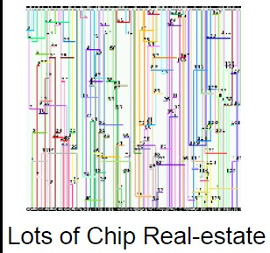
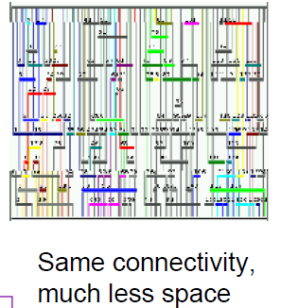
L o cal search
Optimize the number of products purchased by an E-
Commerce user
State: Action taken by the user plus the resulting page-view No track is kept of the path costs between the states
All that is seen is whether the user is buying more products
(or not).

Slide 6
L o cal search
Idea: keep a single “ c u rre n t ” state, and t r y to
improve it.
Move only to neighb ors of t h a t no de.
Advantages:
  No need to maintain a search tree.
  Use very little me m ory.
  Can often find good enough solutions in continuous
or large state spaces.

Slide 7
L o cal search
L o cal Search Algorithms:
  Hill climbing (steepest ascent/descent).
  Local b eam search.
– Genetic algorithms: biology.
inspired by evolutionary

Slide 8
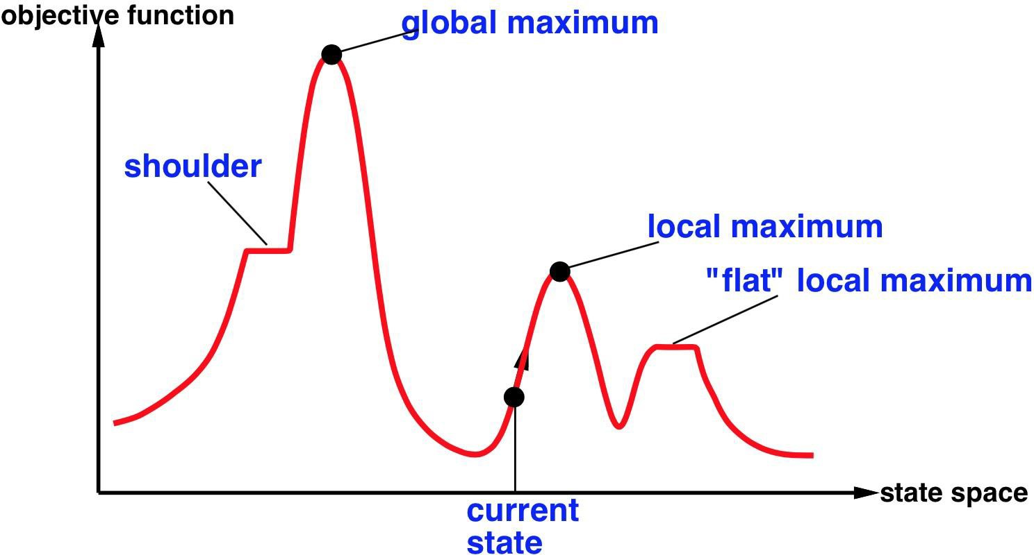
L o cal search
S t a t e
space landscape

Slide 9
Hill climbing
Also called greedy local search.
Looks only to immediate good neighbors and not beyond.
Search moves uphill: moves in the direction of increasing elev a t i o n / v a l u e to find the t o p of the mountai n.
Terminates when it reaches a peak.
Can t e r m i n a te w i t h a lo cal m ax i m u m , global m a x i m u m or can get stuck and no progress is p ossible.
A node is a state and a value.

Slide 10
Hill climbing
"Like climbing Everest in thick fog with amnesia“
A loop that continually moves in the direction of increasing
value, i.e., uphill
Terminates when it reaches a peak where no neighbor has a higher value
Fog with Amnesia: Doesn’t look ahead beyond the immediate
neighbors of the current state.
Unfortunately, hill-climbing
Can get stuck in local maxima
Can be stuck by ridges (a series of local maxima that occur close
together)
Can be stuck by plateaux (a flat area in the state space landscape) Shoulder: if the flat area rises uphill later on
Flat local maximum: no uphill rise exists.

Slide 11
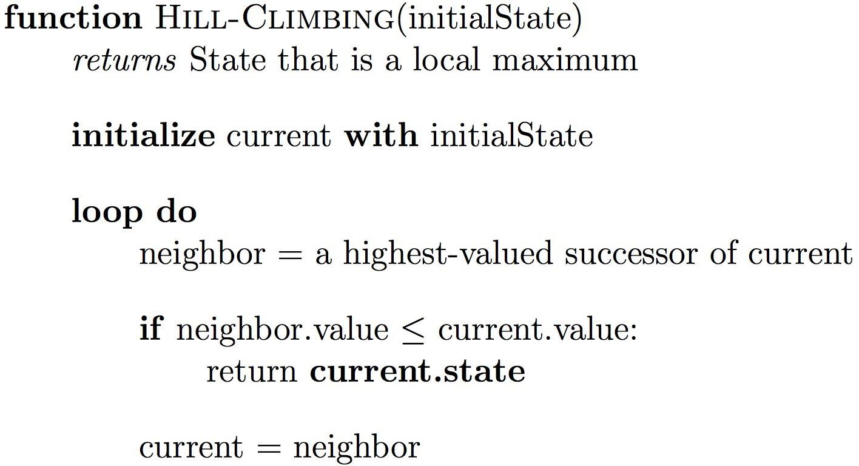
Hill climbing

Slide 12
Hill climbing
O t h e r variants of hill climbing include
Sideways moves escape from plateaux where best successor has same value as the current state .
R a n d o m - r e s t art hill climbing overcomes local maxima: keep
tryin g! (either find a goal or get several possible solution and pick the m a x ) .
Steepest Ascent Backtracking and jump .
Stochastic hill climbing chooses at random among the
uphill moves.

Slide 13

Hill climbing
Hill climbing effective in general but depends on shape of the landscape.
Successful in many real-problems after a reasonable number of
restarts.
Local beam search maintains k states instead of one state.
Select the k b est successor, and useful information is passed among the states.
Stochastic beam search choose k successors are random .
Helps alleviate the problem of the the states agglomerati ng
around the sam e part of the state space.

Slide 14
Genetic algorithms
Genetic algorithms ( G A ) is a variant search.
of sto chastic
b eam
Successor states are generated by combining two parents rather by m o difying a single st a t e .
The process is inspired by natural selection.
Starts w i t h k randomly ge ne r a t e d states, called p opulation. Each state is an individual.
An individual is usually represented by a string of 0’s and 1’s, or digits, a finite set.
T h e objective function is called fitness function : b et t e r states have high values of fitness function.

Slide 15




Genetic algorithms Representation
A proper representation of chromosome is essential for the success of a GA.
Binary Representation: when the solution space consists of boolean decision variables
Integer Representation: To define the genes using discrete variables
Real Valued Representation: To define the genes using continuous rather than discrete variables
Permutation Representation: well suited when solution is represented by an order of elements.
15

Slide 16
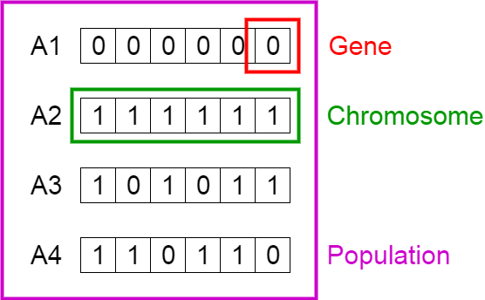
Genetic algorithms
Start with a population of randomly generated Chromosomes, or uses
  A previously saved population
  A set of solutions provided by a human expert
  A set of solutions provided by another heuristic algorithm

Slide 17
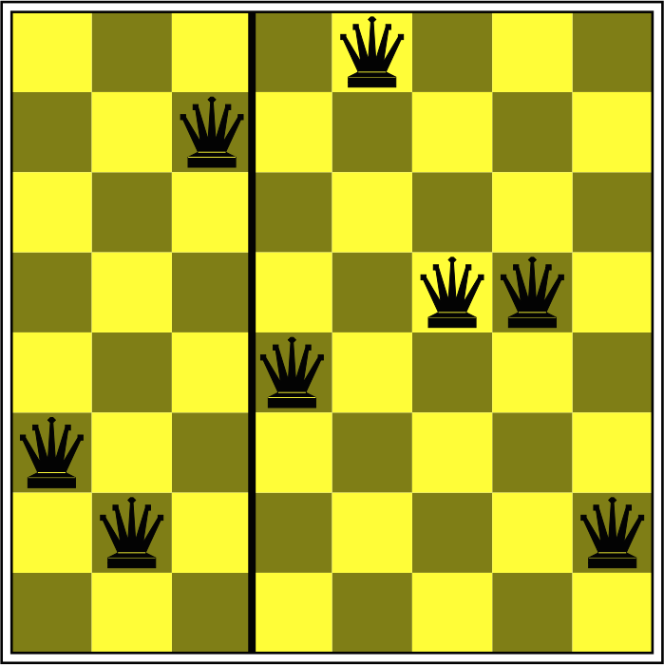
Genetic algorithms
In the 8-queen problem, an individual can b e represented by a string digits 1 to 8, that represents the p osition of the 8 queens in the 8 columns.

Slide 18
Genetic algorithms
T h e objective function is called fitness function : b et t e r states have high values of fitness function.
Possible fitness fu nct i o n is the num b er of non - a t t a c k i n g pairs of queens.
Fitness f unct ion of the solution: 28.

Slide 19

Genetic algorithms
Pairs of individuals are selected at random for
reproduction w.r.t some probabilities.
A crossover point is chosen randomly in the string.
Offspring are created by crossing the parents at the crossover point.
Each element in the string is also subject to
some mutation with a small probability.

Slide 20
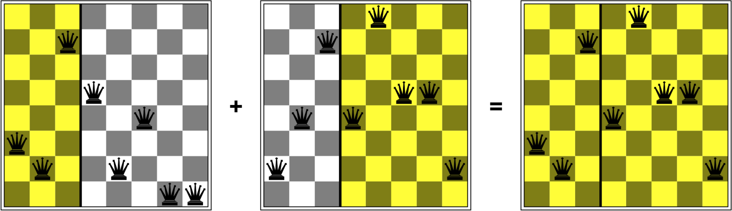
Genetic algorithms

Slide 21
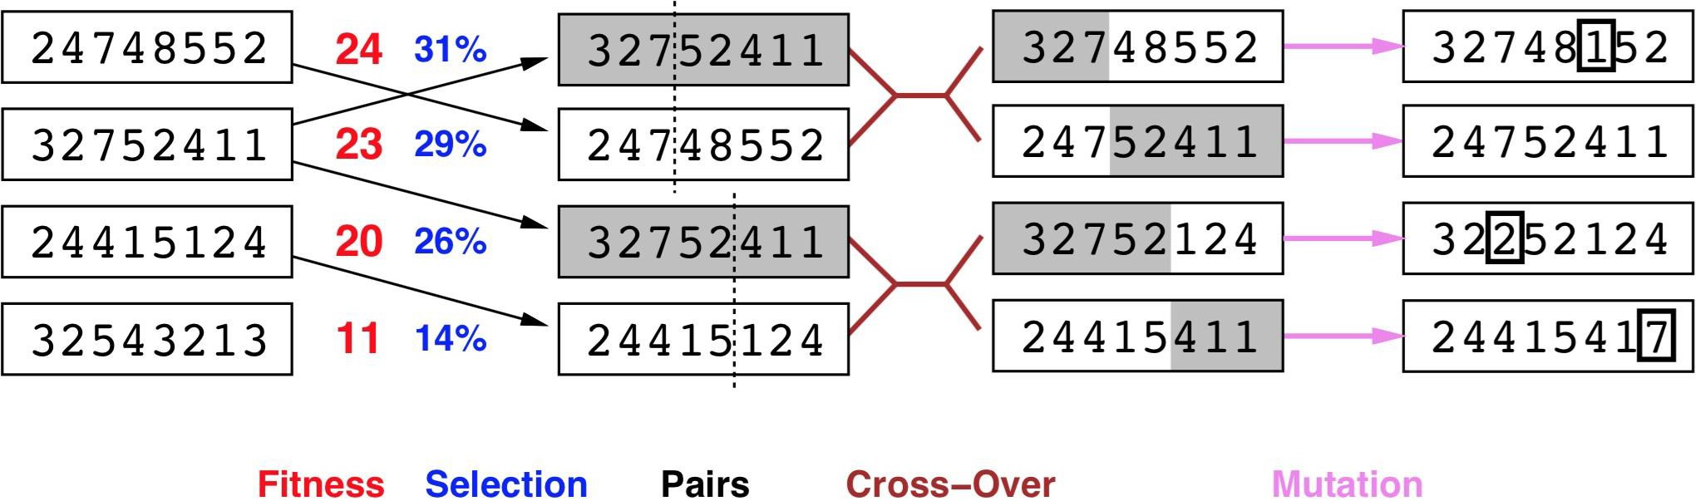
Genetic algorithms
G e n e r a t e successors f r o m pairs of states.

Slide 22
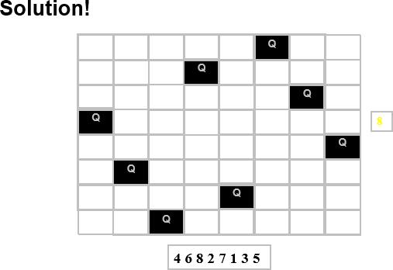

Slide 23
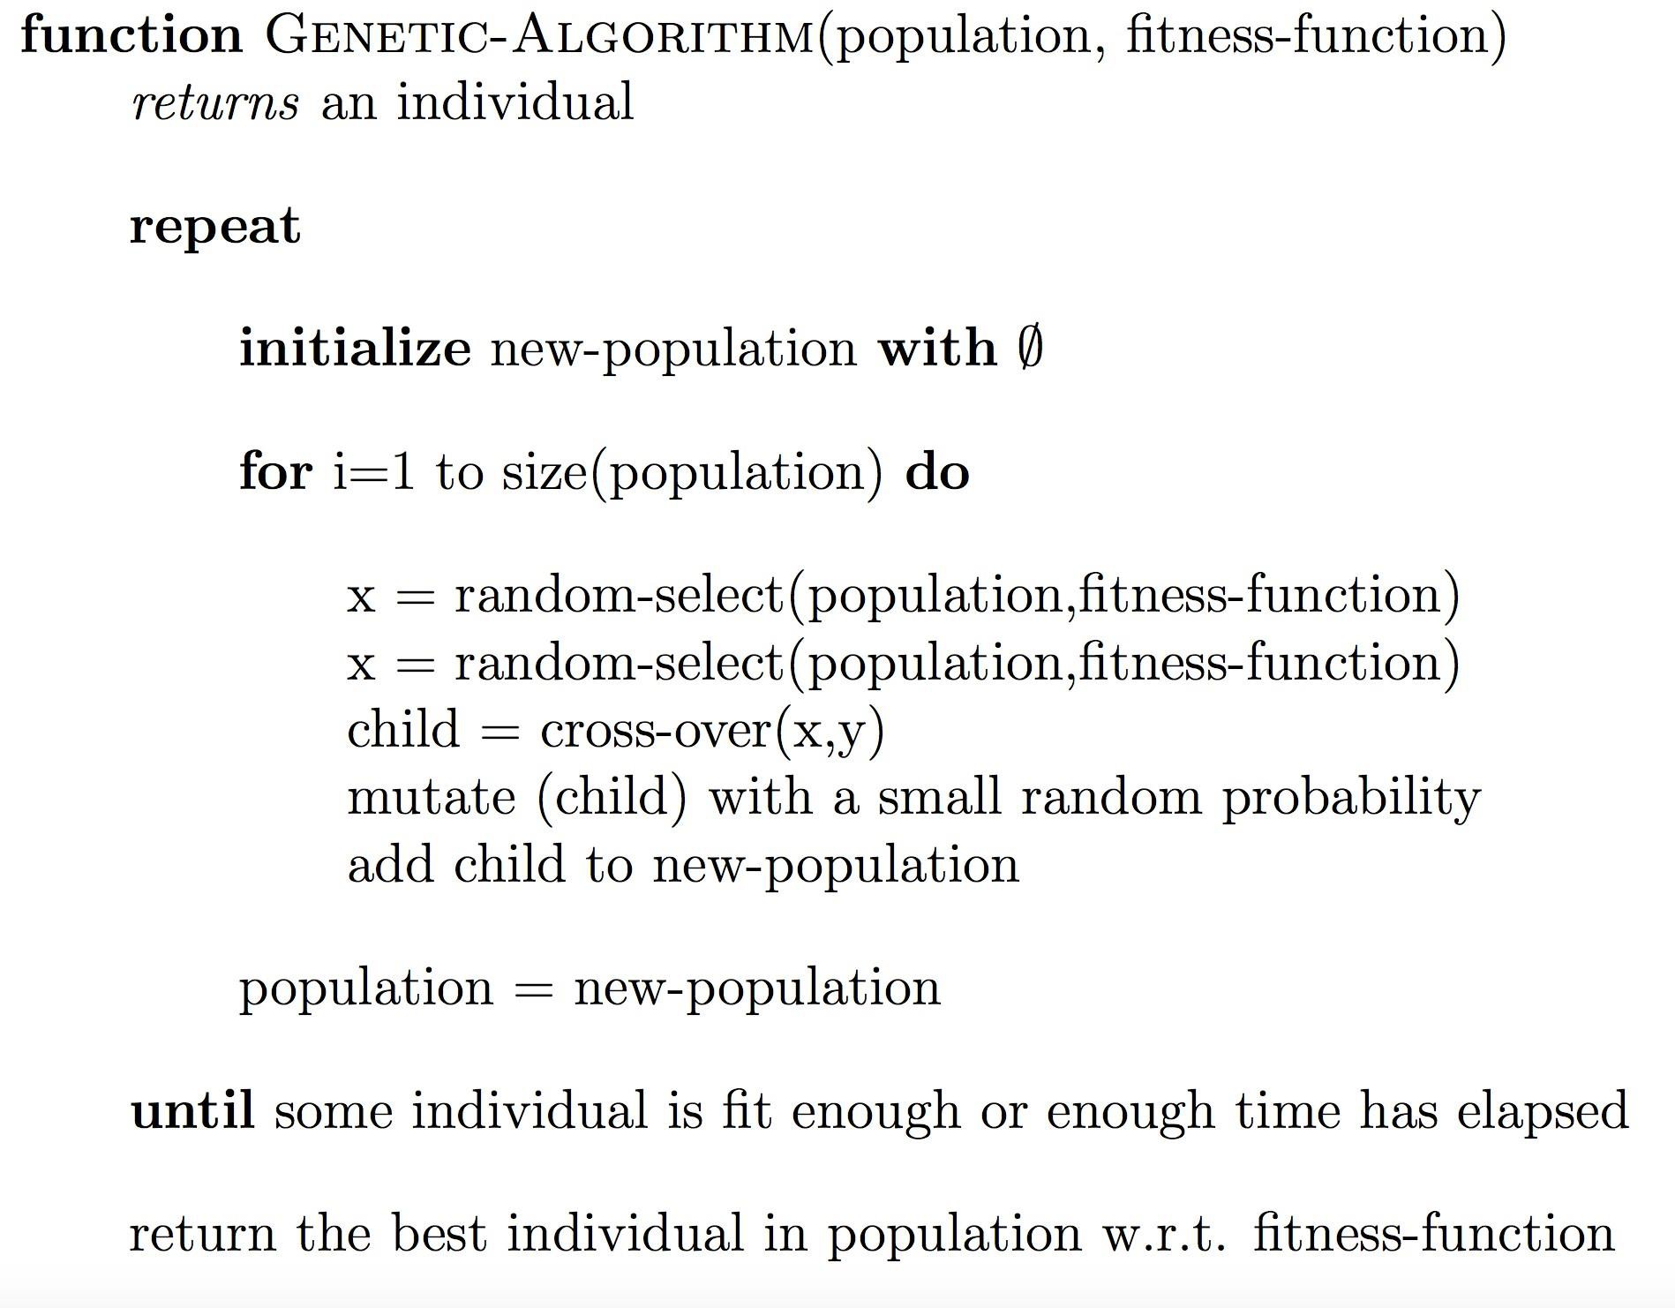
Genetic algorithms

Slide 24
Genetic algorithms
Common terminating conditions are:
  A solution is found that satisfies minimum criteria
  Fixed number of generations reached
  Allocated budget (computation time/money) reached
  The highest ranking solution's fitness is reaching or has reached a plateau such that successive iterations no longer produce better results

Slide 25
Example (initialization)
We toss a fair coin 60 times and get the following initial population:
s₁ = 1111010101
s₂ = 0111000101
s₃ = 1110110101
s₄ = 0100010011
s₅ = 1110111101
s₆ = 0100110000
f (s₁) = 7 f (s₂) = 5 f (s₃) = 7 f (s₄) = 4 f (s₅) = 8 f (s₆) = 3

Slide 26
Example (selection1)
Next we apply fitness proportionate selection with the
roulette wheel method:
We repeat the extraction as many times as the number of individuals we need to have the same parent population size
(6 in our case)
1
2
Area is Proportional to fitness value
n
3
4

Slide 27
Example (selection2)
Suppose that, after performing selection, we get
the following population:
s₁` = 1111010101
s₂` = 1110110101
s₃` = 1110111101
s₄` = 0111000101
s₅` = 0100010011
s₆` = 1110111101
(s₁)
(s₃)
(s₅)
(s₂)
(s₄)
(s₅)

Slide 28
Example (crossover1)
Next we mate strings for crossover. For each couple we decide according to crossover probability (for instance 0.6) whether to actually perform crossover or not
Suppose that we decide to actually perform crossover only for couples (s₁`, s₂`) and (s₅`, s₆`). For each couple, we randomly extract a crossover point, for instance 2 for the first and 5 for the second

Slide 29
Example (crossover2)
Before crossover:
s₁` = 1111010101
s₂` = 1110110101
After crossover:
s₁`` = 1110110101
s₂`` = 1111010101
s₅` = 0100010011
s₆` = 1110111101
s₅`` = 0100011101
s₆`` = 1110110011

Slide 30
Example (mutation1)
The final step is to apply random mutation: for each bit that we are to copy to the new population we allow a small probability of error (for instance 0.1)
Before applying mutation:
s₁`` = 1110110101
s₂`` = 1111010101
s₃`` = 1110111101
s₄`` = 0111000101
s₅`` = 0100011101
s₆`` = 1110110011

Slide 31
Example (mutation2)
After applying mutation:
s₁``` = 1110100101 f (s₁``` ) = 6
s₂``` = 1111110100 f (s₂``` ) = 7 s₃``` = 1110101111 f (s₃``` ) = 8 s₄``` = 0111000101 f (s₄``` ) = 5
s₅``` = 0100011101 f (s₅``` ) = 5
s₆``` = 1110110001 f (s₆``` ) = 6

Slide 32
Example (end)
In one generation, the total population fitness changed from 34 to 37, thus improved by ~9%
At this point, we go through the same process all over again, until a stopping criterion is met

Slide 33
References
Artificial Intelligence: A Modern Approach. S. Russell, and P. Norvig. Series in Artificial Intelligence Prentice Hall, Upper Saddle River, NJ, Third edition, (2010 ). URL: http://aima.cs.berkeley.edu/

